Slide 1

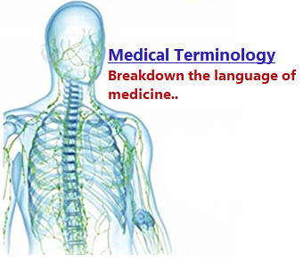
Basic Elements of the Medical Word
Chapter (1)
Faculty of Allied Medical Sciences
Department of Medical Laboratory Sciences

Slide 2
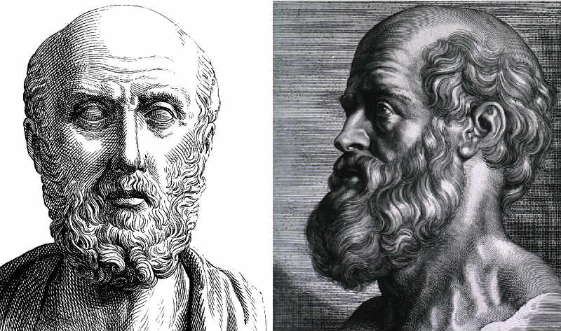
Basic Elements of the Medical Word
Medical Terminology
→ The language of medicine is a specialized vocabulary used by health care practitioners.
→ Originated as early as the first century B.C. by Hippocrates. He is known as the father of western medicine

Slide 3
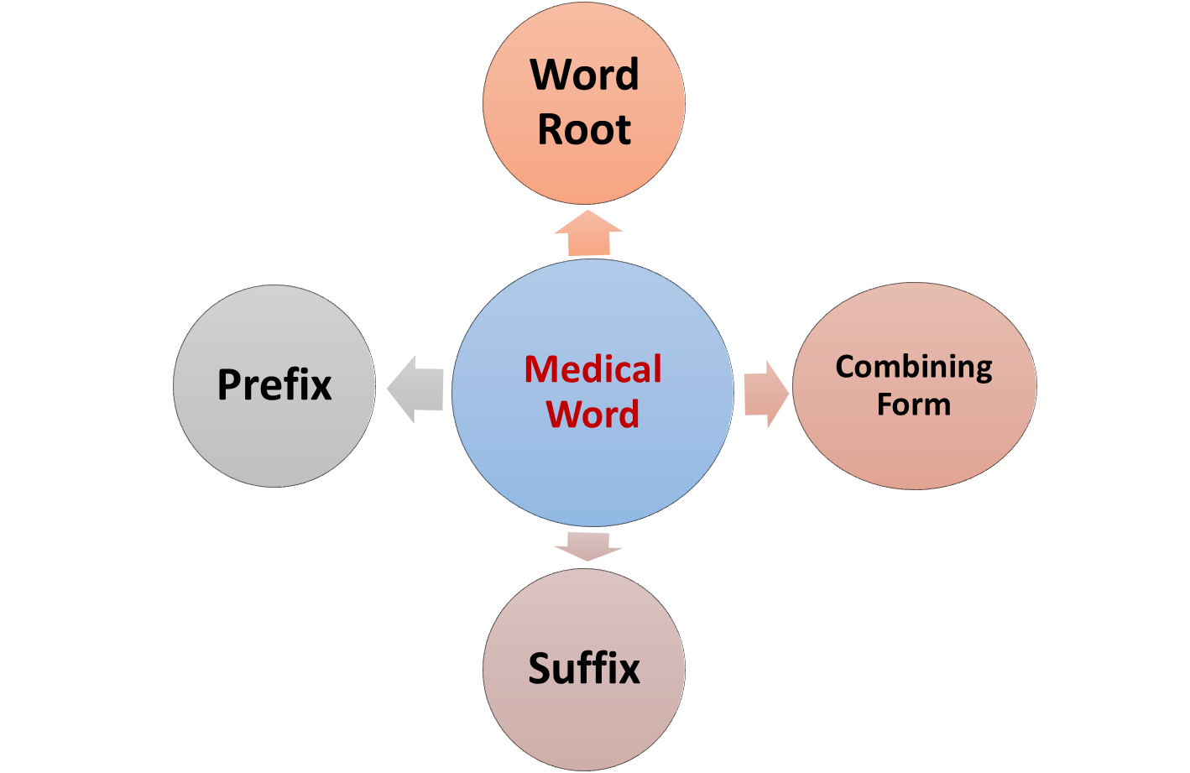
Basic Elements of the Medical Word

Slide 4
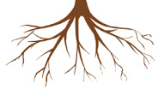
Word Root
Word Root:
The foundation of a medical term and contains its primary meaning.
All medical terms have at least one word root.
Most word roots are derived from Greek or Latin language.
As a general rule:
Greek roots → Used to build words that describe a disease, condition, treatment, or diagnosis.
Latin roots → Used to build words that describe anatomical structures.

Slide 5
Word Root
Greek | Latin | Meaning | Example
Dermatos | Cutane | Skin | Dermat/itis (G): Inflammation of the skin → A term that describes a skin disease Cutan/ous (L): Related to the skin → A term that describes an anatomical structure
Nephros | Renes | Kidneys | Nephr/oma (G): Tumor of the kidney → A term that describes a kidney disease ren/al (L): Related to the kidney → A term that describes an anatomical structure
Stomatos | Oris | Mouth | stomat/it is (G): Inflammation of the mouth or/al (L): Pertaining to the mouth

Slide 6
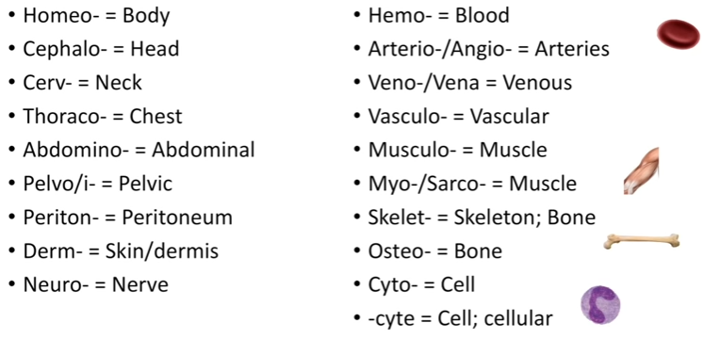
Medical Terminology - Body

Slide 7
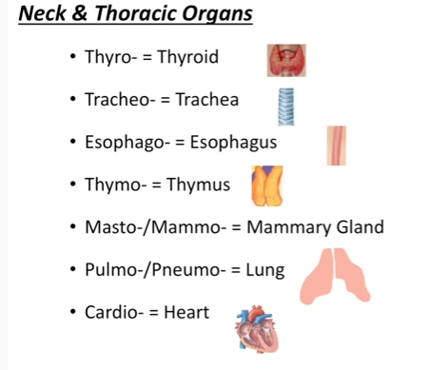
Medical Terminology - Organs

Slide 8
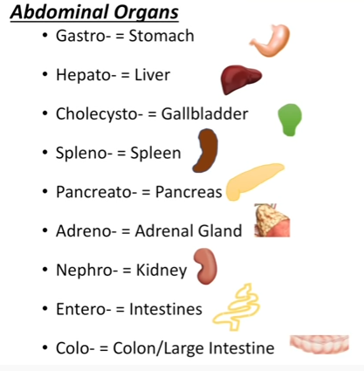
Medical Terminology - Organs

Slide 9
Combining Forms (CF)
Combining Form (CF) is a Word Root (WR) plus a vowel, usually an “o”, but sometimes it is an “i”
The combining vowel has no meaning of its own, but enables two word elements to be connected
Word Root + Vowel | Combining Form | Meaning
erythr/ + o | erythro | red
gastr/ + o | gastro | stomach
hepat/+ o | hepato | liver
immun/ + o | immuno | immune, immunity, safe
nephr/ + o | nephro | kidney
oste/ + o | osteo | bone

Slide 10
Suffixes
A word element placed at the end of a word that changes the meaning of the word.
Suffix usually indicates a procedure, condition, disease, or part of speech
Suffix = means removal
Suffix = means inflammation
Tonsill
itis
Tonsill
ectomy
Root = means small mass of lymphoid tissue in the throat
Root = means small mass of lymphoid tissue in the throat

Slide 11
Suffixes
Combining Form | Suffix | Medical Word
Gastr/o | itis = Inflammation | Gastritis
 | megaly = Enlargemnet | Gastromegaly
 | oma = Tumor | Gastroma
Hepat/o | itis = Inflammation | Hepatitis
 | megaly = Enlargemnet | Hepatomegaly
 | oma = Tumor | Hepatoma

Slide 12
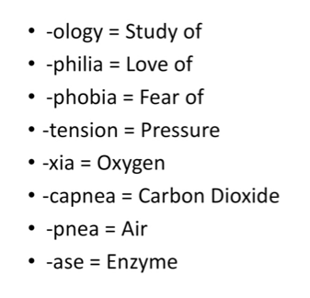
Common Suffixes

Slide 13
Prefixes
A word element located at the beginning of a word
Not all medical terms have a prefix.
Adding or changing a prefix changes the meaning of the word.
Usually indicates a size or amount, number, speed, location, direction, and color.
an + esthes + -ia = anaesthesia → A condition of not feeling
↓ ↓ ↓
(not) (feeling) (condition)
Other examples: hyperthermia, intramascular, paranasal, polyuria

Slide 14
Prefixes
Size & Amount | Numerical | Speed
Macro → Large Micro → small Hyper → High Hypo → Low Eu/Normo → Normal Pan/ Omni → All A/An → Abscent Megalo → Large | Mono → Single Di → Two Tri → Three Quad → Four Poly → Many, a lot Oligo → Few, several | Tachy → Rapid Brady/ Brachy → Slow

Slide 15
Prefixes
Location | Direction | Color
Epi/Peri/Circum → Around Endo/ Intra → Inside Exo-/ Extra → Outer Inter → Between Trans → Across Dia-/ Per → Through Medi(o/a) → Middle Para → Nearby Juxta → Nearby/ Beside | Ab → Away Ad → Toward Dis → To separate | Chrom/Chromato → Color Leuko → White Erythro → Red Cyno → Blue Chloro → Green Melano → Black Flav → Yellow

Slide 16
Defining Medical Words
Three basic steps for defining medical words:
Define the suffix, or last part of the word.
Define the first part of the word (which maybe a word root, combining form, or prefix).
Define the middle parts of the word.
Gastroenteritis
Inflammation of
Stomach and
Intestine
2
3
1

